Slide 1
Vending Machine Example from Last Class
Reset
present inputs next output
state D N state open
0¢ 0 0 0¢ 0
0 1 5¢ 0
1 0 10¢ 0
1 1 – –
5¢ 0 0 5¢ 0
0 1 10¢ 0
1 0 15¢ 0
1 1 – –
10¢ 0 0 10¢ 0
0 1 15¢ 0
1 0 15¢ 0
1 1 – –
15¢ – – 15¢ 1
0¢
N
5¢
D
N
D
10¢
N + D
15¢
[open]
symbolic state table

Slide 2
Vending Machine Example Revisted
(PLD mapping)
D0 = reset'(Q0'N + Q0N' + Q1N + Q1D)
D1 = reset'(Q1 + D + Q0N)
OPEN = Q1Q0
CLK
D
Q
Q0
N
D
Q
Q1
D
D
Q
Open
Reset

Slide 3
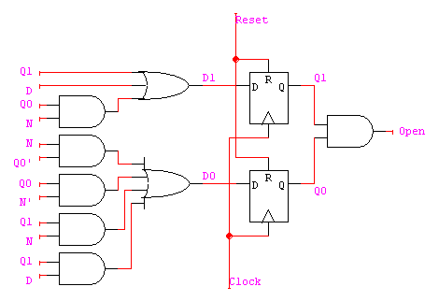
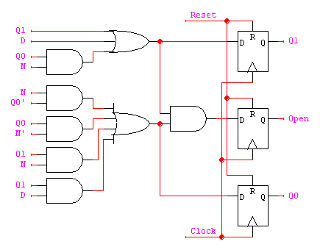
Vending Machine (cont’d)
OPEN = Q1Q0 creates a combinational delay after Q1 and Q0 change
  Clock cycle to set Q1 and Q0 THEN a gate delay THEN an
This can be corrected by retiming, i.e., move flip-flops and logic through each other to improve delay
OPEN = reset'(Q1 + D + Q0N)(Q0'N + Q0N' + Q1N + Q1D)
= reset'(Q1Q0N' + Q1N + Q1D + Q0'ND + Q0N'D)
Implementation now looks like a Mealy machine
  Common for programmable devices to have FF at end of logic

Slide 4
Vending Machine (Retimed PLD Mapping)
OPEN = reset'(Q1Q0N' + Q1N + Q1D + Q0'ND + Q0N'D)
CLK
D
Q
Q0
N
D
Q
Q1
D
OPEN
D
Q
Open
Reset

Slide 5
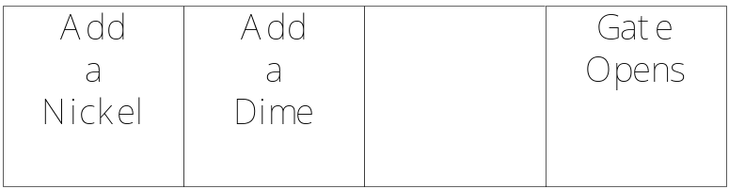
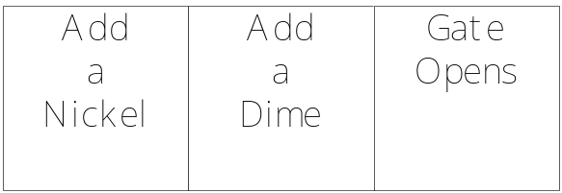
Timing: Before and After
Before
After

Slide 6
Still a Moore Machine?
Yes! Still a latch on all paths from input to output!

Slide 7
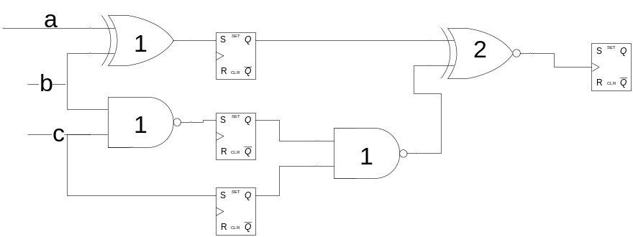
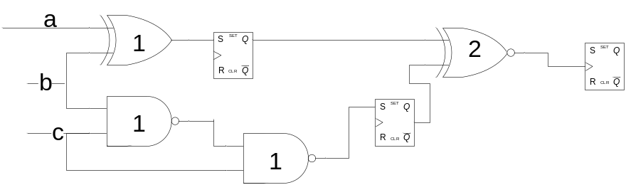
“Retiming”: Moving Latches Around
Key Observation: Can make circuits faster and smaller by moving latches without changing circuit function
Clock cycle =3
Clock cycle =2

Slide 8
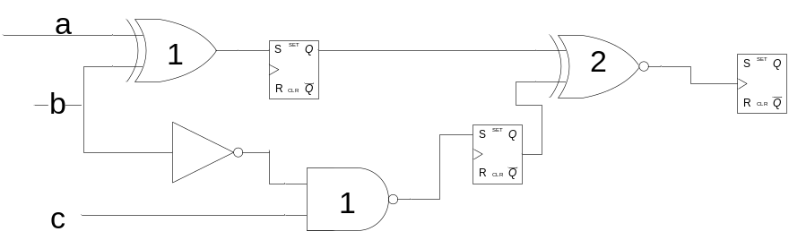
Can Simplify the Logic

Slide 9
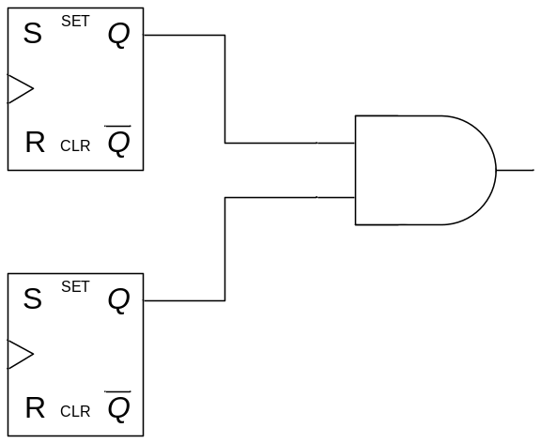
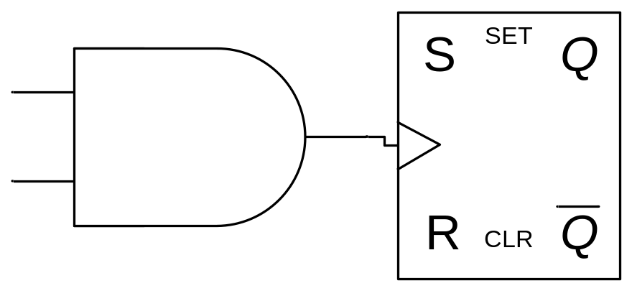
Basic Transformation
Used to Reduce cycle time
Used to reduce number of cycles
Apply basic transformation repeatedly…
Graph-theoretic algorithm does this automatically

Slide 10
Sequential Logic Implementation
Summary
Models for representing sequential circuits
  Abstraction of sequential elements
  Finite state machines and their state diagrams
  Inputs/outputs
  Mealy, Moore, and synchronous Mealy machines
Finite state machine design procedure
  Verilog specification
  Deriving state diagram
  Deriving state transition table
  Determining next state and output functions
  Implementing combinational logic

Slide 11
Verilog Synthesis
Synthesis vs. Compilation
Descriptions mapped to hardware
Verilog design patterns for best synthesis

Slide 12
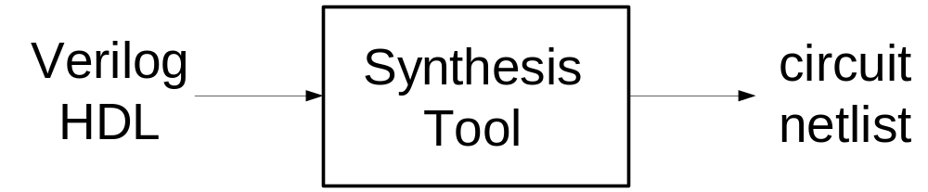
Logic Synthesis
Verilog and VHDL started out as simulation languages, but soon programs were written to automatically convert Verilog code into low-level circuit descriptions (netlists).
Synthesis converts Verilog (or other HDL) descriptions to an implementation using technology-specific primitives:
  For FPGAs: LUTs, flip-flops, and RAM blocks
  For ASICs: standard cell gate and flip-flop libraries, and memory blocks

Slide 13
Why Perform Logic Synthesis?
Automatically manages many details of the design process:
  Fewer bugs
  Improves productivity
Abstracts the design data (HDL description) from any particular implementation technology
  Designs can be re-synthesized targeting different chip technologies; E.g.: first implement in FPGA then later in ASIC
In some cases, leads to a more optimal design than could be achieved by manual means (e.g.: logic optimization)
Why Not Logic Synthesis?
May lead to less than optimal designs in some cases

Slide 14
How Does It Work?
Variety of general and ad-hoc (special case) methods:
  Instantiation: maintains a library of primitive modules (AND, OR, etc.) and user defined modules
  “Macro expansion”/substitution: a large set of language operators
  (+, -, Boolean operators, etc.) and constructs (if-else, case) expand into special circuits
  Inference: special patterns are detected in the language description and treated specially (e.g.,: inferring memory blocks from variable declaration and read/write statements, FSM detection and generation from “always @ (posedge clk)” blocks)
  Logic optimization: Boolean operations are grouped and optimized with logic minimization techniques
  Structural reorganization: advanced techniques including sharing of operators, and retiming of circuits (moving FFs), and others

Slide 15
Operators
Logical operators map into primitive logic gates
Arithmetic operators map into adders, subtractors, …
  Unsigned 2s complement
  Model carry: target is one-bit wider that source
  Watch out for *, %, and /
Relational operators generate comparators
Shifts by constant amount are just wire connections
  No logic involved
Variable shift amounts a whole different story --- shifter
Conditional expression generates logic or MUX
Y = ~X << 2
X[3]
Y[5]
X[2]
Y[4]
X[1]
Y[3]
X[0]
Y[2]
Y[1]
Y[0]

Slide 16
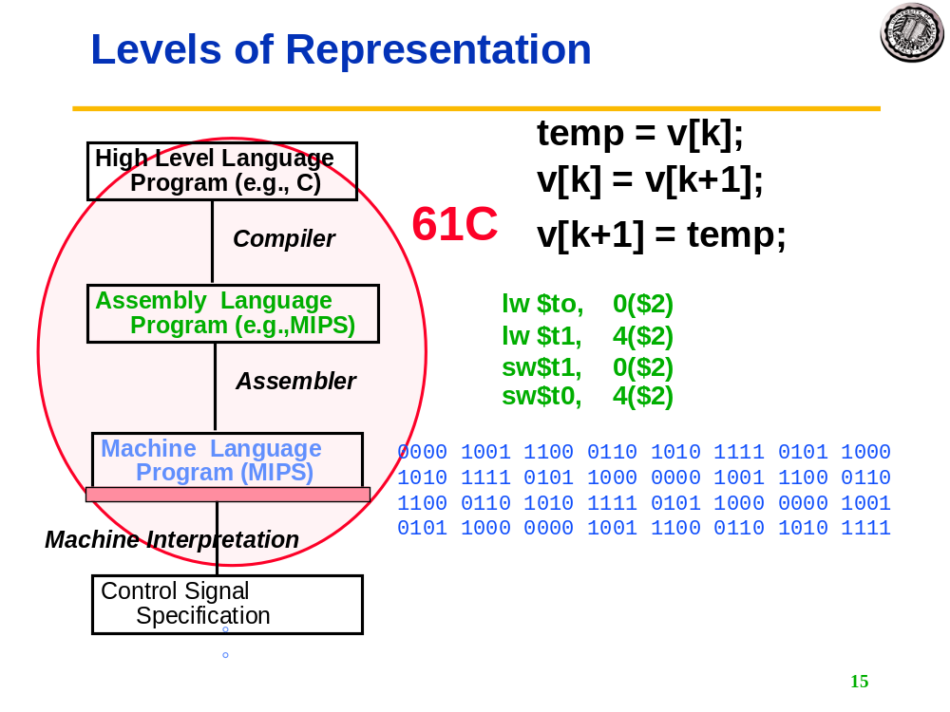
Synthesis vs. Compilation
Compiler
  Recognizes all possible constructs in a formally defined program language
  Translates them to a machine language representation of execution process
Synthesis
  Recognizes a target dependent subset of a hardware description language
  Maps to collection of concrete hardware resources
  Iterative tool in the design flow

Slide 17
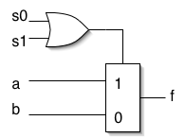
Simple Example
module foo (a,b,s0,s1,f);
input [3:0] a;
input [3:0] b;
input s0,s1;
output [3:0] f;
reg f;
always @ (a or b or s0 or s1)
if (!s0 && s1 || s0) f=a; else f=b;
endmodule
Should expand if-else into 4-bit wide multiplexer (a, b, f are 4-bit vectors) and optimize/minimize the control logic:

Slide 18
Module Template
Synthesis tools expects to find modules in this format.
module <top_module_name>(<port list>);
/* Port declarations. followed by wire, reg, integer, task and function declarations */
/* Describe hardware with one or more continuous assignments, always blocks, module instantiations and gate instantiations */
// Continuous assignment
wire <result_signal_name>;
assign <result_signal_name> = <expression>;
// always block
always @(<event expression>)
begin
// Procedural assignments
// if statements
// case, casex, and casez statements
// while, repeat and for loops
// user task and user function calls
end
// Module instantiation
<module_name> <instance_name> (<port list>);
// Instantiation of built-in gate primitive
gate_type_keyword (<port list>);
endmodule
Order of these statements is irrelevant, all execute concurrently
Statements between the begin and end in an always block execute sequentially from top to bottom (however, beware of blocking versus non-blocking assignment)
Statements within a fork-join statement in an always block execute concurrently

Slide 19
Procedural Assignments
Verilog has two types of assignments within always blocks:
Blocking procedural assignment “=“
  RHS is executed and assignment is completed before the next statement is executed; e.g.,
    Assume A holds the value 1 … A=2; B=A; A is left with 2, B with 2.
Non-blocking procedural assignment “<=“
  RHS is executed and assignment takes place at the end of the current time step (not clock cycle); e.g.,
    Assume A holds the value 1 … A<=2; B<=A; A is left with 2, B with 1.
Notion of “current time step” is tricky in synthesis, so to guarantee that your simulation matches the behavior of the synthesized circuit, follow these rules:
  Use blocking assignments to model combinational logic within an always block
  Use non-blocking assignments to implement sequential logic
  Do not mix blocking and non-blocking assignments in the same always block
  Do not make assignments to the same variable from more than one always block

Slide 20
Supported Verilog Constructs
  Net types: wire, tri, supply1, supply0; register types: reg, integer, time (64 bit reg); arrays of reg
  Continuous assignments
  Gate primitive and module instantiations
  always blocks, user tasks, user functions
  inputs, outputs, and inouts to a module
  All operators (+, -, *, /, %, <, >, <=, >=, ==, !=, ===, !==, &&, ||, !, ~, &, ~&, |, ~|, ^~, ~^, ^, <<, >>, ?:, { }, {{ }}) [Note: / and % are supported for compile-time constants and constant powers of 2]
  Procedural statements: if-else-if, case, casex, casez, for, repeat, while, forever, begin, end, fork, join
  Procedural assignments: blocking assignments =, nonblocking assignments <= (Note: <= cannot be mixed with = for the same register).
  Compiler directives: `define, `ifdef, `else, `endif, `include, `undef
  Miscellaneous:
    Integer ranges and parameter ranges
    Local declarations to begin-end block
    Variable indexing of bit vectors on the left and right sides of assignments

Slide 21
Unsupported Language Constructs
Generate error and halt synthesis
Simply ignored
Net types: trireg, wor, trior, wand, triand, tri0, tri1, and charge strength;
register type: real
Built-in unidirectional and bidirectional switches, and pull-up, pull-down
Procedural statements: assign (different from the “continuous assignment”), deassign, wait
Named events and event triggers
UDPs (user defined primitives) and specify blocks
force, release, and hierarchical net names (for simulation only)
Delay, delay control, and drive strength
Scalared, vectored
Initial block
Compiler directives (except for `define, `ifdef, `else, `endif, `include, and `undef, which are supported)
Calls to system tasks and system functions (they are only for simulation)

Slide 22
Combinational Logic
CL can be generated using:
  Primitive gate instantiation:
    AND, OR, etc.
  Continuous assignment (assign keyword), example:
  Module adder_8 (cout, sum, a, b, cin);
  output cout;
  output [7:0] sum;
  input cin;
  input [7:0] a, b;
  assign {cout, sum} = a + b + cin;
  endmodule
  Always block:
  always @ (event_expression)
  begin
  // procedural assignment statements, if statements,
  // case statements, while, repeat, and for loops.
  // Task and function calls
  end

Slide 23
Combinational Logic Always Blocks
Make sure all signals assigned in a combinational always block are explicitly assigned values every time that the always block executes--otherwise latches will be generated to hold the last value for the signals not assigned values!
module mux4to1 (out, a, b, c, d, sel);
output out;
input a, b, c, d;
input [1:0] sel;
reg out;
always @(sel or a or b or c or d)
begin
case (sel)
2'd0: out = a;
2'd1: out = b;
2'd3: out = d;
endcase
end
endmodule
Example:
  Sel case value 2’d2 omitted
  Out is not updated when select line has 2’d2
  Latch is added by tool to hold the last value of out under this condition

Slide 24
Combinational Logic Always Blocks (cont.)
To avoid synthesizing a latch in this case, add the missing select line:
2'd2: out = c;
Or, in general, use the “default” case:
default: out = foo;
If you don’t care about the assignment in a case (for instance you know that it will never come up) then assign the value “x” to the variable; E.g.:
default: out = 1‘bx;
The x is treated as a “don’t care” for synthesis and will simplify the logic
(The synthesis directive “full_case” will accomplish the same, but can lead to differences between simulation and synthesis.)

Slide 25
Latch Rule
If a variable is not assigned in all possible executions of an always statement then a latch is inferred
  E.g., when not assigned in all branches of an if or case
  Even a variable declared locally within an always is inferred as a latch if incompletely assigned in a conditional statement

Slide 26
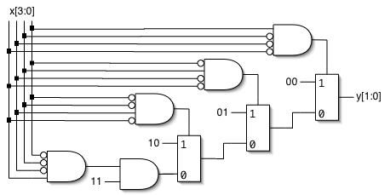
Encoder Example
Nested IF-ELSE might lead to “priority logic”
  Example: 4-to-2 encoder
This style of cascaded logic may adversely affect the performance of the circuit
always @(x)
begin : encode
if (x == 4'b0001) y = 2'b00;
else if (x == 4'b0010) y = 2'b01;
else if (x == 4'b0100) y = 2'b10;
else if (x == 4'b1000) y = 2'b11;
else y = 2'bxx;
end

Slide 27
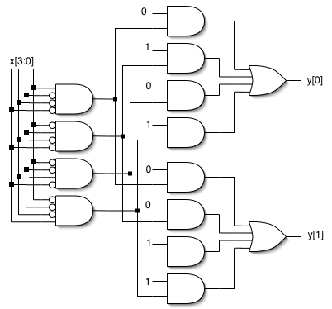
Encoder Example (cont.)
To avoid “priority logic” use the case construct:
All cases are matched in parallel
Note, you don’t need the “parallel case” directive (except under special circumstances, described later)
always @(x)
begin : encode
case (x)
4’b0001: y = 2'b00;
4’b0010: y = 2'b01;
4'b0100: y = 2'b10;
4'b1000: y = 2'b11;
default: y = 2'bxx;
endcase
end

Slide 28
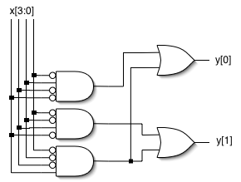
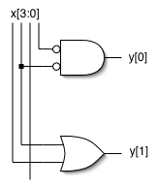
Encoder Example (cont.)
Circuit would be simplified during synthesis to take advantage of constant values as follows and other Boolean equalities:
A similar simplification would be applied to the if-else version also

Slide 29
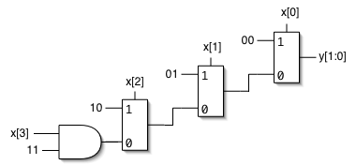
Encoder Example (cont.)
If you can guarantee that only one 1 appears in the input (one hot encoding), then simpler logic can be generated:
If the input applied has more than one 1, then this version functions as a “priority encoder” -- least significant 1 gets priority (the more significant 1’s are ignored); the circuit will be simplified when possible
always @(x)
begin : encode
if (x[0]) y = 2'b00;
else if (x[1]) y = 2'b01;
else if (x[2]) y = 2'b10;
else if (x[3]) y = 2'b11;
else y = 2'bxx;
end

Slide 30
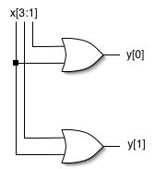
Encoder Example (cont.)
Parallel version, assuming we can guarantee only one 1 in the input:
Note now more than one case might match the input
Therefore use “parallel case” directive: without it, synthesis adds appropriate matching logic to force priority
  Semantics of case construct says that the cases are evaluated from top to bottom
  Only an issue for synthesis when more than one case could match input
always @(x)
begin : encode
casex (x) // synthesis parallel_case
4’bxxx1: y = 2'b00;
4’bxx1x: y = 2'b01;
4'bx1xx: y = 2'b10;
4'b1xxx: y = 2'b11;
default: y = 2'bxx;
endcase
end

Slide 31
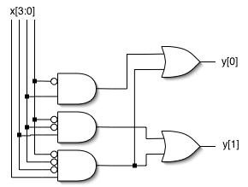
Encoder Example (cont.)
Parallel version of “priority encoder”:
Note: “parallel case” directive is not used, synthesis adds appropriate matching logic to force priority
  Just what we want for a priority encoder
Behavior matches that of the if-else version presented earlier
always @(x)
begin : encode
casex (x)
4’bxxx1: y = 2'b00;
4’bxx1x: y = 2'b01;
4'bx1xx: y = 2'b10;
4'b1xxx: y = 2'b11;
default: y = 2'bxx;
endcase
end

Slide 32
Sequential Logic
Example: D flip-flop with synchronous set/reset:
module dff(q, d, clk, set, rst);
input d, clk, set, rst;
output q;
reg q;
always @(posedge clk)
if (reset)
q <= 0;
else if (set)
q <= 1;
else
q <= d;
endmodule
“@ (posedge clk)” key to flip-flop generation
Note in this case, priority logic is appropriate
For Xilinx Virtex FPGAs, the tool infers a native flip-flop
  No extra logic needed for set/reset
We prefer synchronous set/reset,
but how would you specify
asynchronous preset/clear?
s
d
q
clk
r

Slide 33
Finite State Machines
module FSM1(clk,rst, enable, data_in, data_out);
input clk, rst, enable;
input data_in;
output data_out;
/* Defined state encoding;
this style preferred over ‘defines */
parameter default=2'bxx;
parameter idle=2'b00;
parameter read=2'b01;
parameter write=2'b10;
reg data_out;
reg [1:0] state, next_state;
/* always block for sequential logic */
always @(posedge clk)
if (rst) state <= idle;
else state <= next_state;
Style guidelines (some of these are to get the right result, and some just for readability)
  Must have reset
  Use separate always blocks for sequential and combination logic parts
  Represent states with defined labels or enumerated types

Slide 34
FSMs (cont.)
/* always block for CL */
always @(state or enable or data_in)
begin
case (state)
/* For each state def output and next */
idle : begin
data_out = 1’b0;
if (enable)
next_state = read;
else next_state = idle;
end
read : begin … end
write : begin … end
default : begin
next_state = default;
data_out = 1’bx;
end
endcase
end
endmodule
Use CASE statement in an always to implement next state and output logic
Always use default case and assert the state variable and output to ‘bx:
  Avoids implied latches
  Allows use of don’t cares leading to simplified logic
“FSM compiler” within synthesis tool can re-encode your states; Process is controlled by using a synthesis attribute (passed in a comment).
  Details in Synplify guide

Slide 35

More Help
Online documentation for Synplify Synthesis Tool:
  Under Documents/General Documentation, see Synplify Web Site/Literature:
  http://www.synplicity.com/literature/index.html
  Online examples from Synplicity
Bhasker is a good synthesis reference
Trial and error with the synthesis tool
  Synplify will display the output of synthesis in schematic form for your inspection--try different input and see what it produces

Slide 36
Bottom-line
Have the hardware design clear in your mind when you write the verilog
Write the verilog to describe that HW
  It is a Hardware Description Language not a Hardware Imagination Language
If you are very clear, the synthesis tools are likely to figure it out

